Slide 1
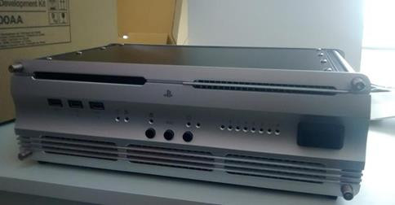
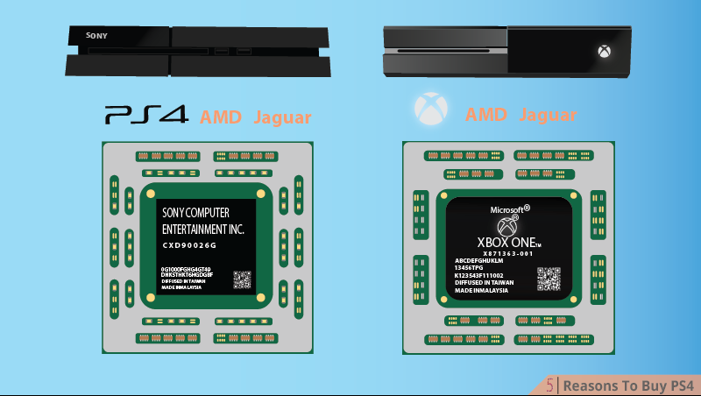
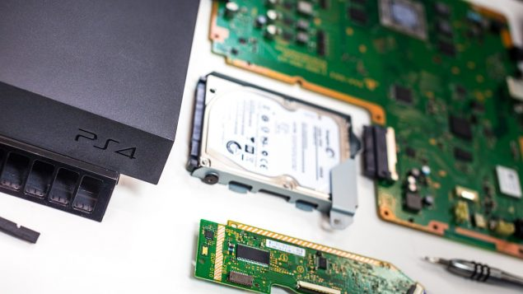
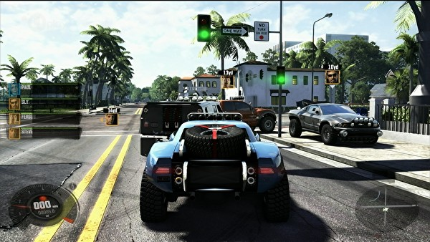
Programming for Graphics
Graphics pipeline and shaders

Slide 2
Shaders

Slide 3
What are shaders
Shaders are small programs that run on the GPU
We can program these shaders using one of several C like languages
HLSL (High Level Shader Language, Direct X)
GLSL (Graphics library Shader language, Open GL)
CG (C for Graphics, Nvidia’s attempt to unify shaders for both DX and Open GL)
Shader lab (Unity’s implementation of CG)

Slide 4
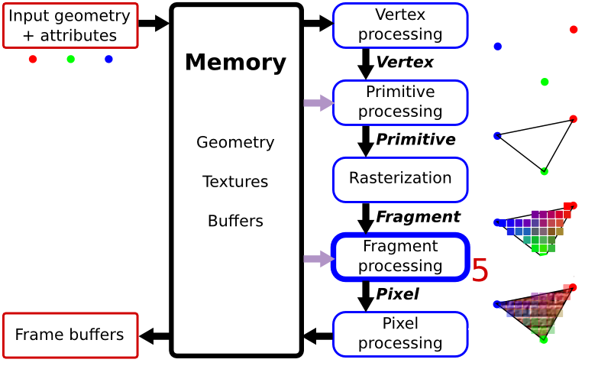
The graphics pipeline
All programmable stages can access the shared memory
Data can be directly passed on to the next shader.
What stages are programmable?
The vertex shader
The geometry shader
The fragment shader

Slide 5
Lighting, Texturing, Shading
Transformation, Texturing and Lighting
What if…
We could write a program that controls these
What if…
These programs could execute in dedicated hardware
What if…
We could write these programs in a high-level language
That’s what shaders are for!

Slide 6
What do they do?
Everything
Vertex shaders are part of the geometry creation process
The geometry shader allows you to add more triangles to your mesh, on the fly.
The fragment shader allows you to mess with the colours (sounds boring but its really not)

Slide 7
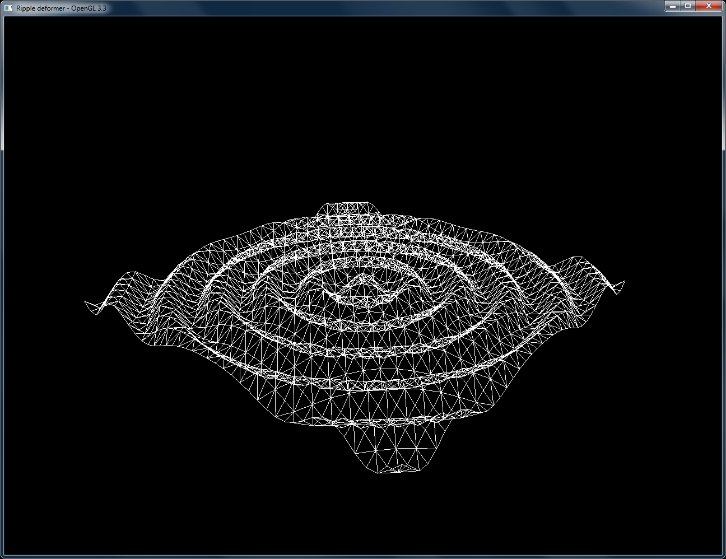
Vertex shader
It can directly effect vertex information.
You can move them around
Calculate the normal direction of a tri
Calculate the tangent and bi tangent (useful later on in the fragment shader).

Slide 8
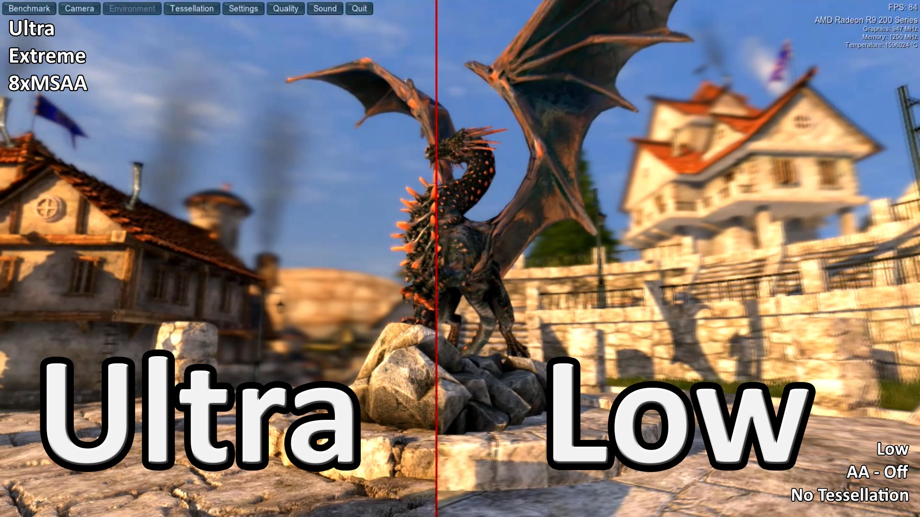
Geometry shader
Allows you to create geometry on the fly, using a map or generating it yourself

Slide 9
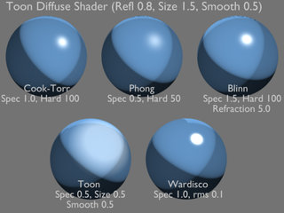
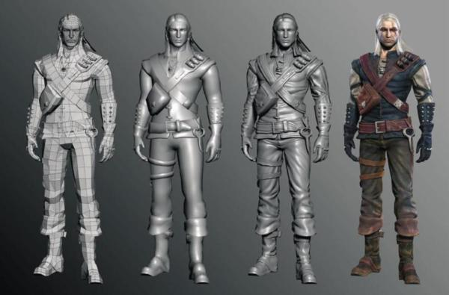
Fragment shader
Applies colour information to a surface
textures
Colour
Lighting
Shadow
Normal maps

Slide 10
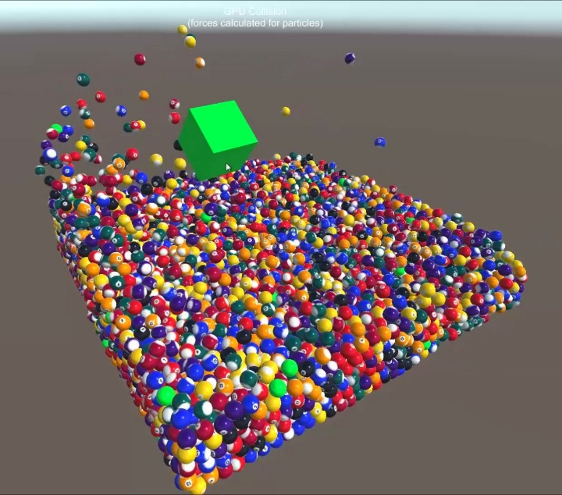
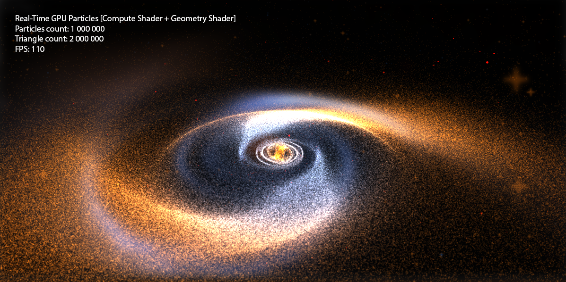
The compute shader
For when your CPU just isn't Fast enough!
There is a 4th shader called the compute shader
This is separate from the graphics pipeline as it is used to process data on the GPU, data that YOU send.

Slide 11

Why is it faster?
Because GPU’s are not the same as CPUs…..
There slower, usually around the 1.5GHz mark*
But there are thousands of them!
* I wrote this years ago and haven't updated in in a while. Gpu’s are still slower than CPUs but they could be faster than 1.5ghz now.

Slide 12
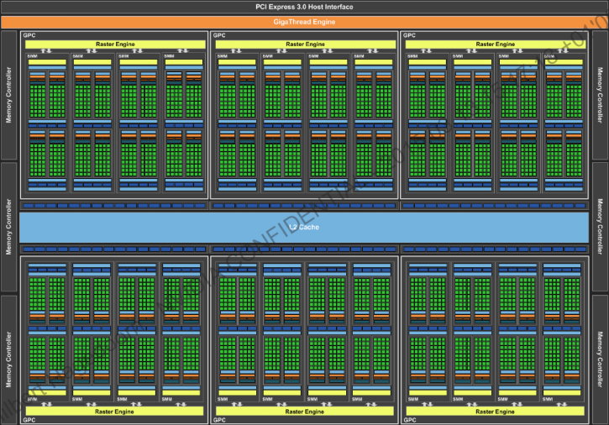
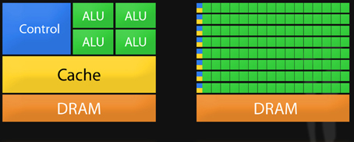
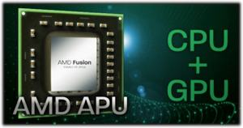
Comparison!
This is your CPU
This is your GPU
This is your GPU!
1000’s of tiny processors, waiting to do your bidding!
No Wait!

Slide 13
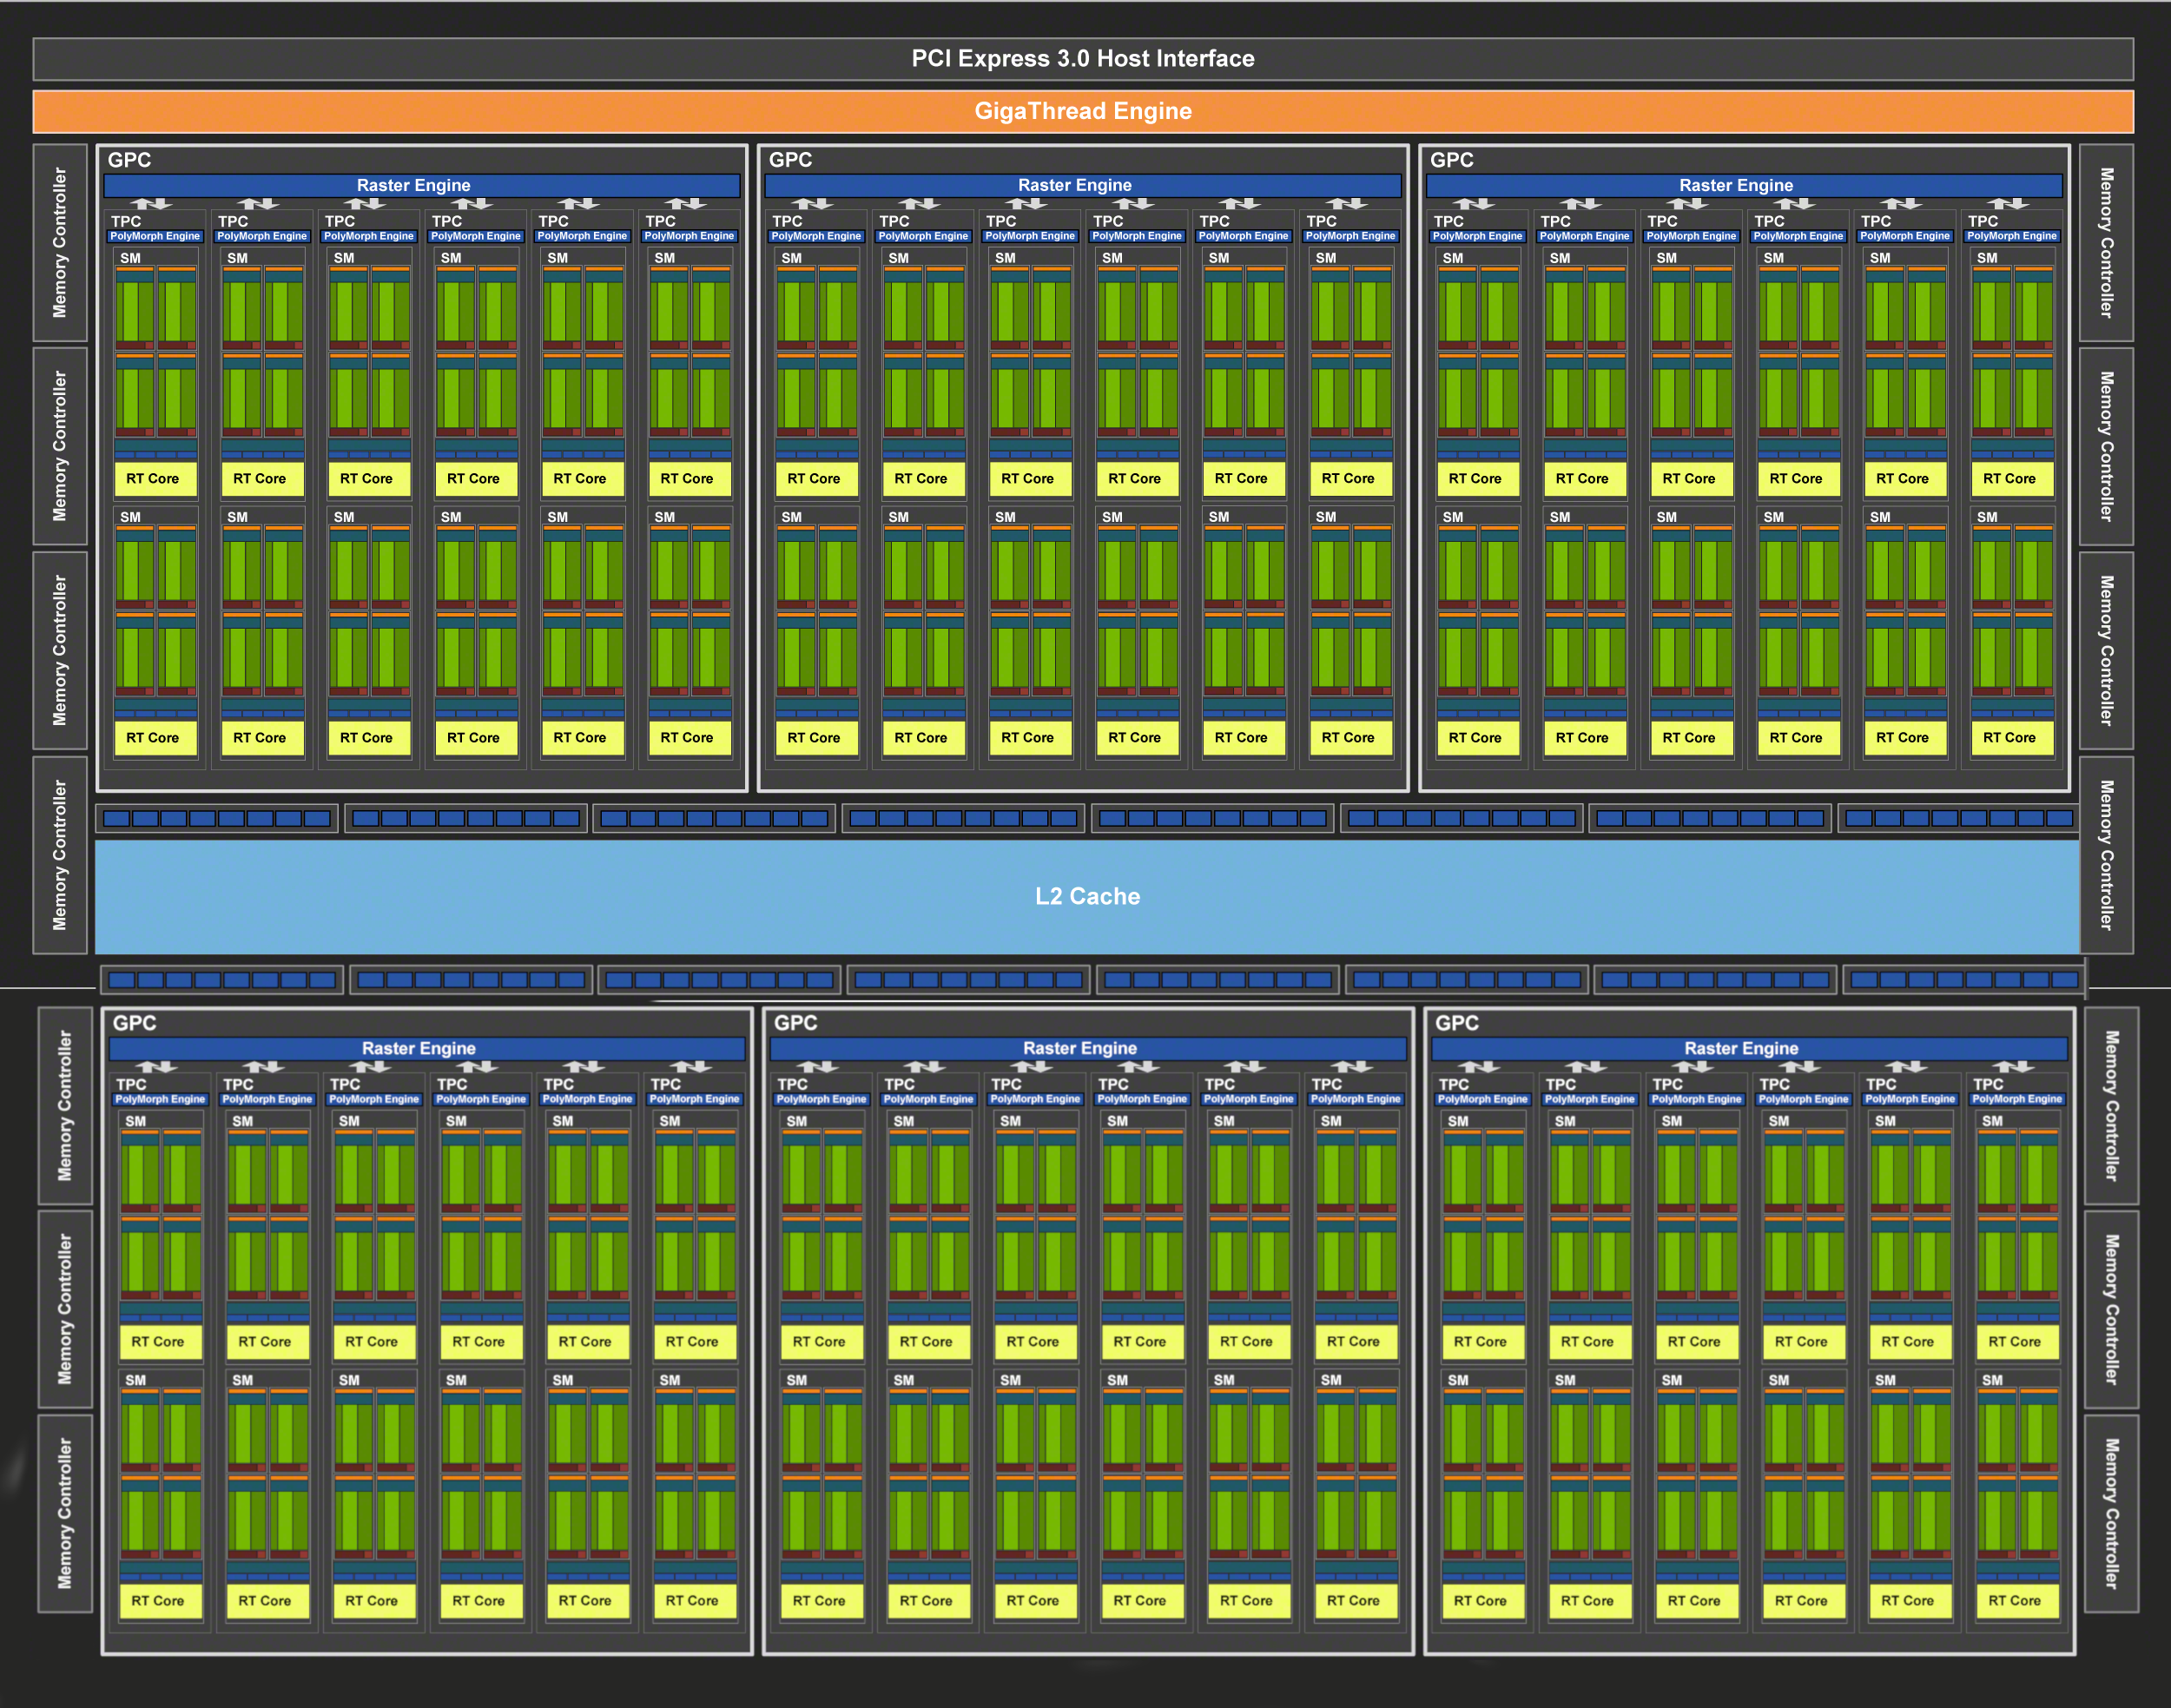
And this is what a 2080 looks like.
It has more cuda cores than this projector has pixels

Slide 14
Why do we care?
Because you can override the standard shaders to do cool things….

Slide 15
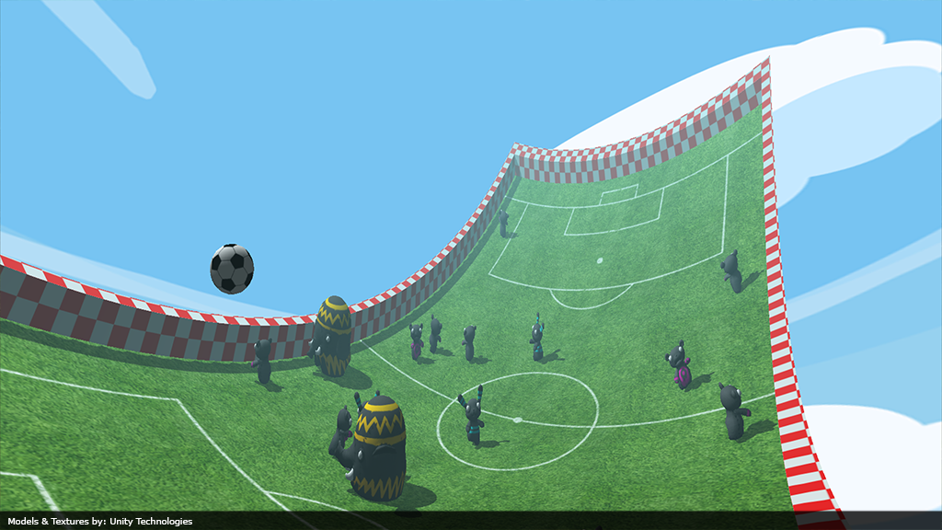
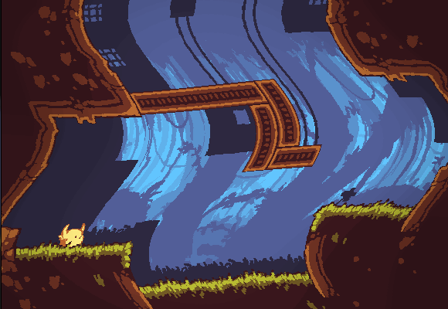
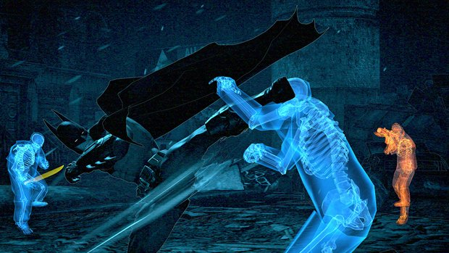
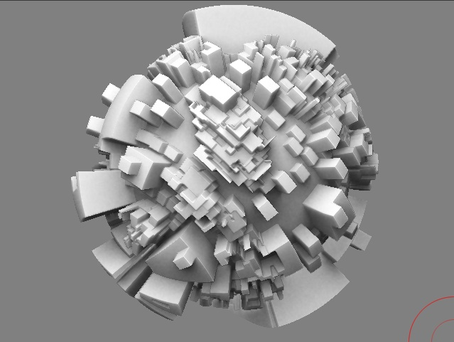
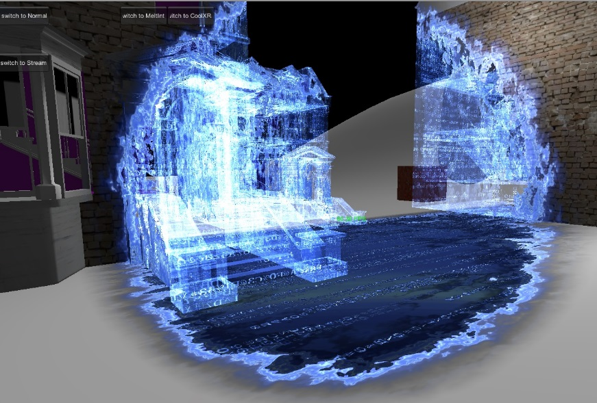
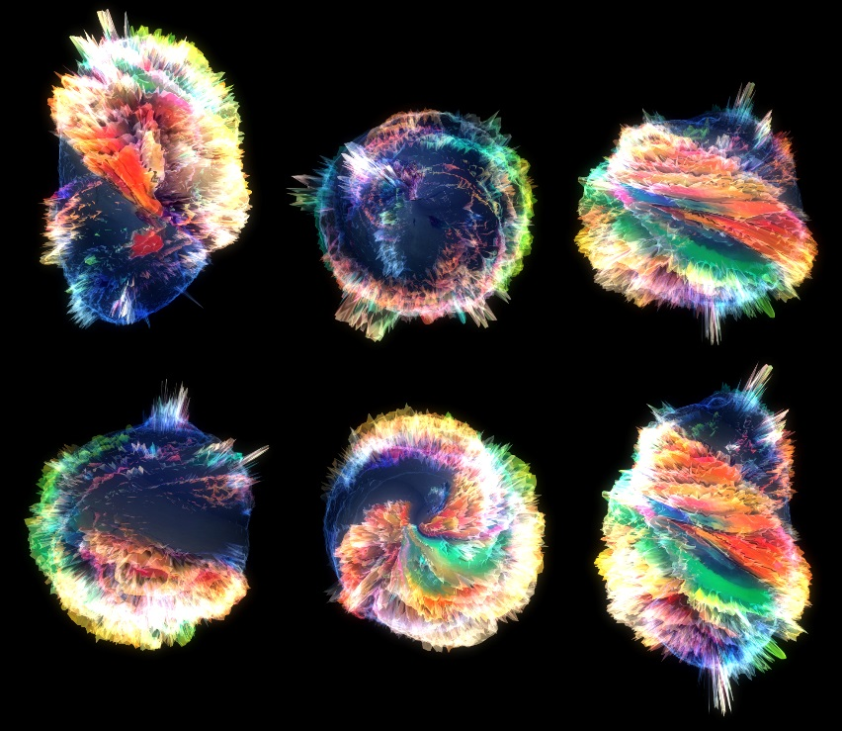
Like this

Slide 16
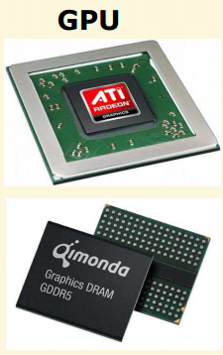
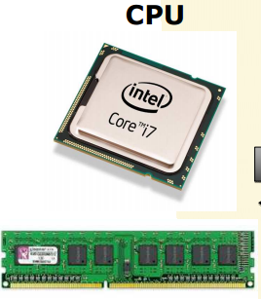
GPU vs CPU
CPU
Very general
– Suited to run normal application code.
Instructs GPU
GPU
Highly specialized
Vector calculations
Massively parallel
Waits for CPU commands

Slide 17
Key Trend in OpenGL Evolution
Complex
Configurability
Simple
Configurability
Shaders!
High-level languages
Fixed-function
Programmable
Direct3D/Playstation follows the same trend
Also reflects trend in GPU architecture
API and hardware co-evolving

Slide 18
Programming Shaders inside GPU
Multiple programmable domains within the GPU
Can be programmed in high-level languages
Cg, HLSL, or OpenGL Shading Language (GLSL)
3D Application or Game
OpenGL API
CPU – GPU Boundary
GPU
Front End
Vertex Assembly
Primitive Assembly
Clipping, Setup,
and Rasterization
Raster
Operations
Vertex
Shader
Geometry
Program
Fragment
Shader
Attribute Fetch
Legend
Parameter Buffer Read
Texture Fetch
Framebuffer Access
programmable
fixed-function
Memory Interface
OpenGL 3.3

Slide 19
Example Simple Shaders
Vertex Shader
Operates on each vertex of geometric primitives
Passes through per-vertex color
Transforms the vertex to match fixed-function processing
Fragment Shader
Operates on each fragment (think pixel)
Outputs the fragment’s interpolated color to the framebuffer
void main(void)
{
gl_FrontColor = gl_Color;
gl_Position = ftransform();
}
void main(void)
{
gl_FragColor = gl_Color;
}

Slide 20
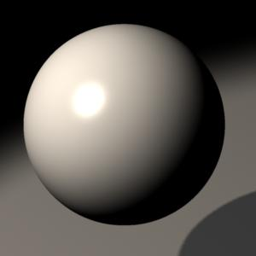
Low-level Assembly vs.High-level Shading Language
Low-level OpenGL Assembly
ADDR R0.xyz,eyePosition.xyzx,-f[TEX0].xyzx;
DP3R R0.w, R0.xyzx, R0.xyzx;
RSQR R0.w, R0.w;
MULR R0.xyz, R0.w, R0.xyzx;
ADDR R1.xyz,lightPosition.xyzx,-f[TEX0].xyzx;
DP3R R0.w, R1.xyzx, R1.xyzx;
RSQR R0.w, R0.w;
MADR R0.xyz, R0.w, R1.xyzx, R0.xyzx;
MULR R1.xyz, R0.w, R1.xyzx;
DP3R R0.w, R1.xyzx, f[TEX1].xyzx;
MAXR R0.w, R0.w, {0}.x;
SLER H0.x, R0.w, {0}.x;
DP3R R1.x, R0.xyzx, R0.xyzx;
RSQR R1.x, R1.x;
MULR R0.xyz, R1.x, R0.xyzx;
DP3R R0.x, R0.xyzx, f[TEX1].xyzx;
MAXR R0.x, R0.x, {0}.x;
POWR R0.x, R0.x, shininess.x;
MOVXC HC.x, H0.x;
MOVR R0.x(GT.x), {0}.x;
MOVR R1.xyz, lightColor.xyzx;
MULR R1.xyz, Kd.xyzx, R1.xyzx;
MOVR R2.xyz, globalAmbient.xyzx;
MOVR R3.xyz, Ke.xyzx;
MADR R3.xyz, Ka.xyzx, R2.xyzx, R3.xyzx;
MADR R3.xyz, R1.xyzx, R0.w, R3.xyzx;
MOVR R1.xyz, lightColor.xyzx;
MULR R1.xyz, Ks.xyzx, R1.xyzx;
MADR R3.xyz, R1.xyzx, R0.x, R3.xyzx;
MOVR o[COLR].xyz, R3.xyzx;
MOVR o[COLR].w, {1}.x;
High-level Cg
float3 L = normalize(lightPosition–position.xyz);
float3 H = normalize(L + normalize(eyePosition –
position.xyz));
color.xyz = Ke + (Ka * globalAmbient) +
Kd * lightColor * max(dot(L, N), 0) +
Ks * lightColor * pow(max(dot(H, N), 0), shininess);
color.w = 1;

Slide 21




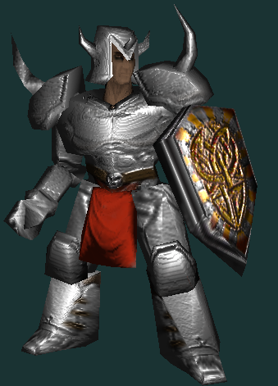
Building Up Shaders
×
×
(
) + (
) =
Diffuse
Decal
Specular
Gloss
Result

Slide 22
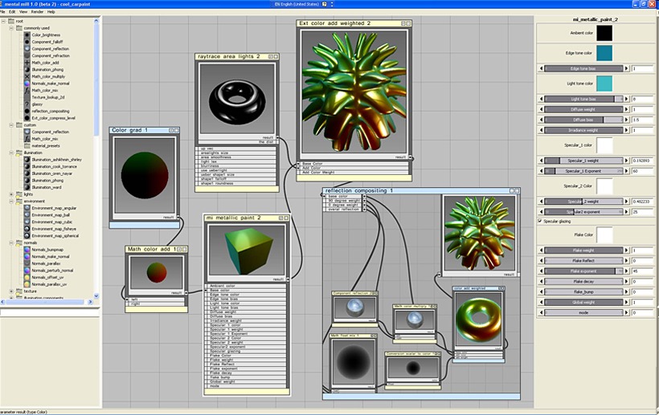
Managing Shader Operations Graphically

Slide 23


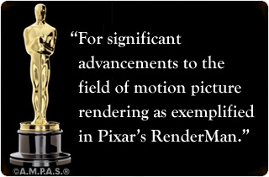
Pioneering Shading Language
RenderMan Shading Language
Developed by Pixar
Academy Award winning!
For production rendering of animated films
Still in use
Intended for CPU-based rendering system
Not oriented for graphics hardware
Assumes a micro-polygon style renderer

Slide 24
Shading Language Evolution
General-purpose languages
C
(AT&T, 1970’s)
IRIS GL
(SGI, 1982)
RenderMan
(Pixar, 1988)
Graphics Application Program Interfaces
Shading Languages
Reality Lab
(RenderMorphics, 1994)
OpenGL
(ARB, 1992)
PixelFlow Shading Language
(UNC, 1998)
C++
(AT&T, 1983)
Direct3D
(Microsoft, 1995)
Real-Time Shading Language
(Stanford, 2001)
Java (Sun, 1994)
Cg / HLSL (NVIDIA/Microsoft, 2002)
GLSL (3DLabs/ATI/NVIDIA, 2003)
GLSL ES2 (Khronos, 2003)

Slide 25
OpenGL Shading Language
Known as GLSL
Part of core OpenGL 2.0 and beyond
Uses a C-like language
Authoring of vertex and fragment shaders
Later added geometry shaders (GL 3.0) and tessellation shaders (GL 4.0+)
DirectX – High Level Shader Language (HLSL)
PlayStation® Shader Language (PSSL)
Similar to GLSL

Slide 26
Shader Language Overview
C-like
C-style syntax and control flow
Adds graphics features
First-class vertex and matrix data types
Texture samplers
Graphics-oriented standard library
Including built-in OpenGL state variables
Uniform and varying parameters, interpolation qualifiers
Various modern language features
bool, // comments, limited overloaded functions
in/out/inout function parameters
Minus features of C not suited for GPUs
Pointers, unions, multi-dimensional arrays
goto, string literals, standard C library stuff like printf and malloc

Slide 27
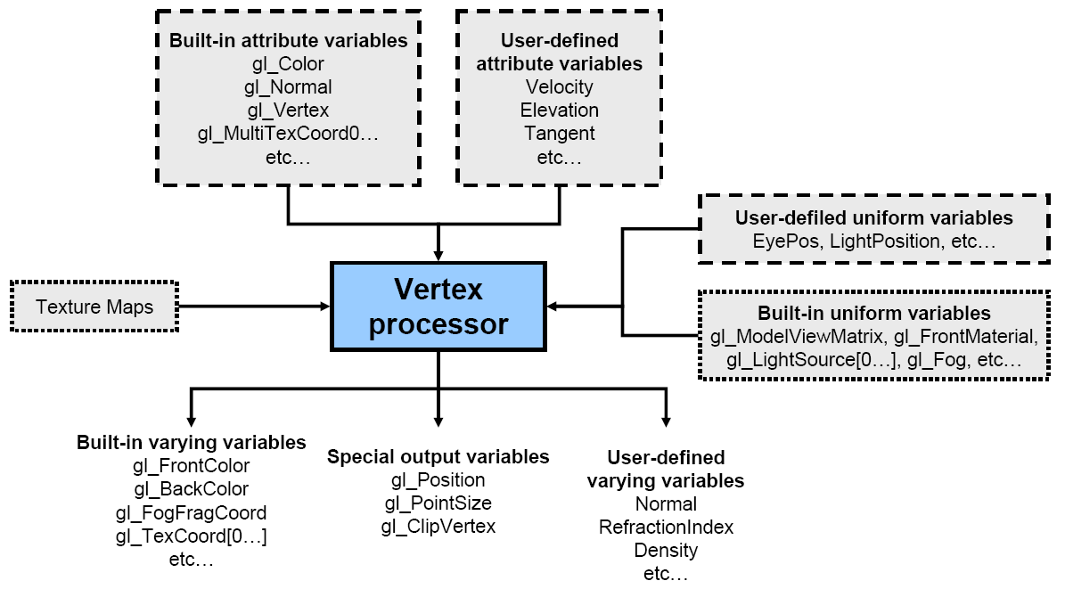
Vertex Shader Inputs & Outputs

Slide 28
Fragment Shader Ins & Outs

Slide 29
GLSL Implementation
GLSL is built into drivers (e.g., OpenGL)
Means your graphics driver contains an optimizing compiler for a high-level language
Targeting a complex, dedicate processor
What could possibly go wrong?
Well, you might want to test your shaders on hardware from different vendors (hint, careful about Intel Integrated Graphics)
But fairly mature at this point, assuming good drivers
GLSL shaders compiled to hardware-dependent shader micro-code
Details all hidden from the OpenGL application programmer
Provides very little visibility into compiled result
NVIDIA’s Cg Toolkit contains compiler for Cg and GLSL code that can show you an assembly level view of your program
Use –oglsl option to accept GLSL language into cgc compiler
Shaders execution in Single Program, Multiple Data (SPMD) model
Means (in latest GPUs) that each shader instance can branch differently
More powerful than Single Instruction, Multiple Data (SIMD) model

Slide 30
Take Away Information
Shading gets complicated
High-level shading languages have completely removed the need for the assembly level shading
GLSL is the OpenGL Shading Language
But Cg and HLSL are also widely used
Multiple programmable domains in pipeline
Vertex and fragment domains
More recently: primitive (geometry) and tessellation

Slide 31
Things to do this week

Slide 32
Create a class for your shader.
this class should:
Load shader files (they come as text)
Have the following functions
Bind (this will use the shader program for this shader)
Update (this will update the uniform variables every frame)
How you build this class is up to you, and forms part of your assessment. I'm not going to show you this. Thought you will see me use shader files, update and bind methods

Slide 33
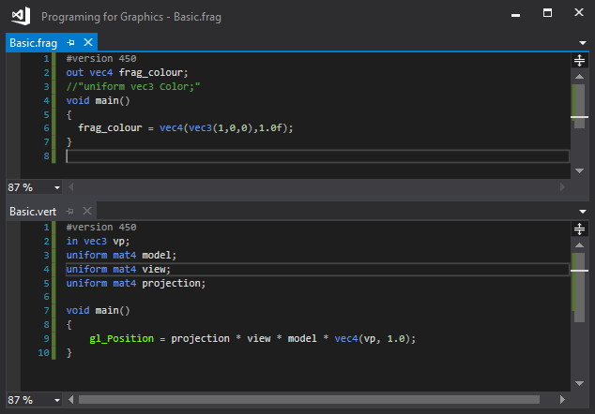
Shader files
Shader files are text files with different extension
.vert
.frag
They look like this >>>>>
There just like the char arrays we had but each shader is in its own file.

Slide 34
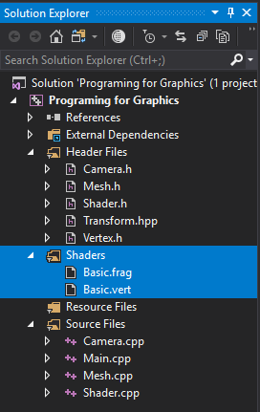
You can download and install an extension for visual studio called: GLSL Language integration (https://marketplace.visualstudio.com/items?itemName=DanielScherzer.GLSL)
This will provide you with code highlighting for .vert and .frag files
Just be sure they are included in the solution.

Slide 35
Questions?

Slide 36
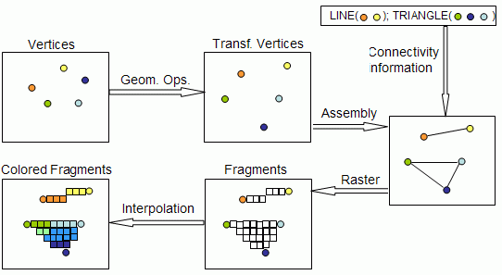
Vertices to Pixels
Vertex Data
(Positions, Colours, Texture Coordinates, ..)
Indices
(Connections of Vertices to form geometry/triangles)

